Slide 1
Chapter 2
Sums

Slide 2
Sums
Topics:
Sequences and Notations
Sums and Recurrences
General Methods

Slide 3
Sums
Learning Outcome:
Understand sequences and notation
Understanding Sums and Recurrences
Different methods to solve problems

Slide 4
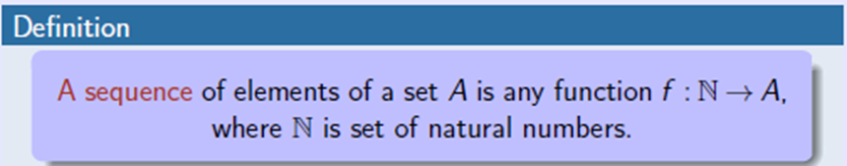
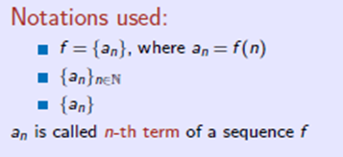
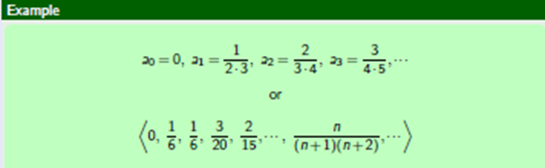
2.1 Sequences

Slide 5
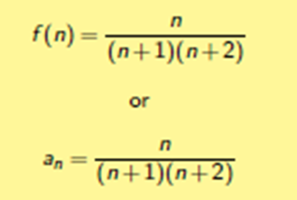
2.2 Notation Example

Slide 6
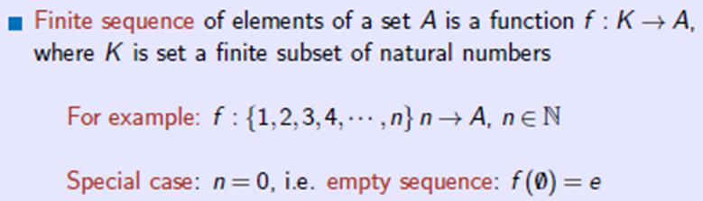
2.3 Finite Sequence

Slide 7
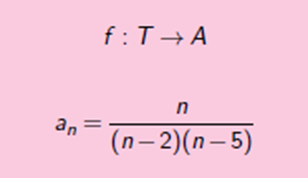

2.4 Domain of Sequence

Slide 8
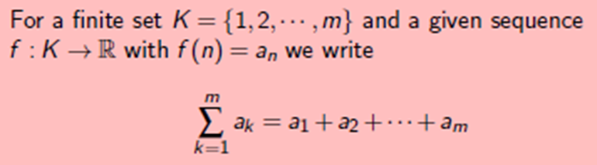
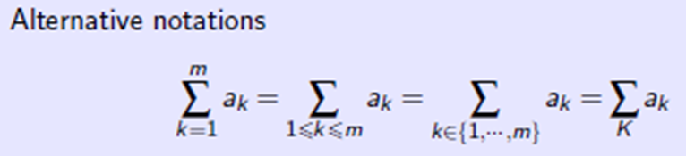
2.5 Notations for Sums

Slide 9
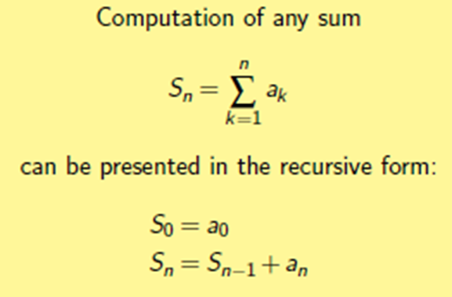
Sums and Recurrences

Slide 10
Repertoire Method
What is Repertoire Method?
Ans: The repertoire method is really a tool to help with the intuitive step of figuring out a closed formula for a recurrence equation. It does so by breaking the original problem into smaller parts, with the hope they might be easier to solve.
So we can say that, we have a function determined by a recurrence relation and we want to find a closed formula for it. The recurrence being linear, we assume this closed form is a linear combination of 3 other functions, with coefficients α,β and γ.

Slide 11
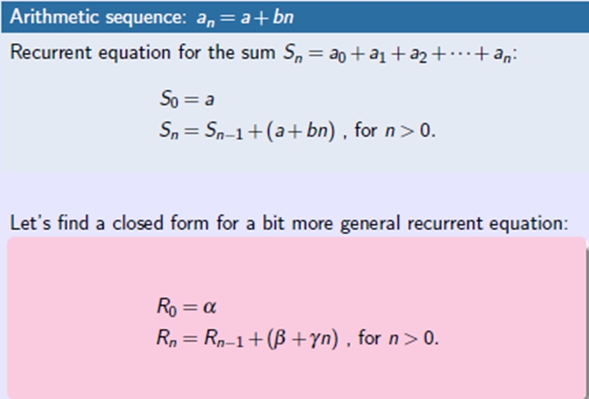
Example-1: Using Repertoire Method

Slide 12
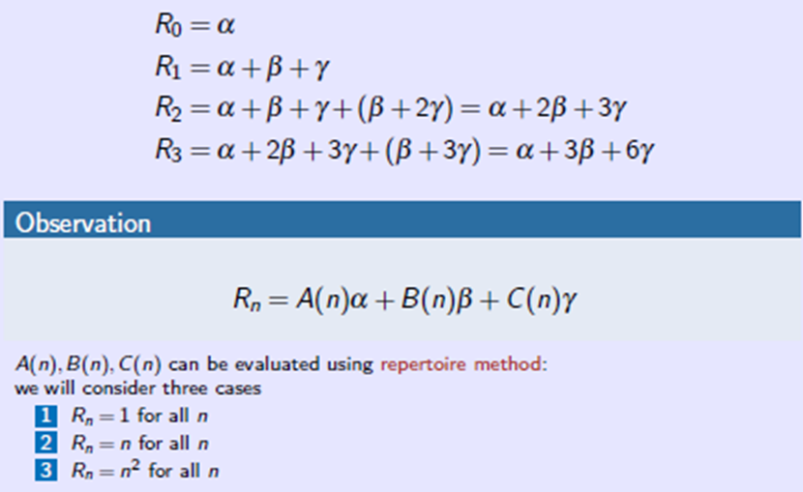
Example-1: Using Repertoire Method

Slide 13
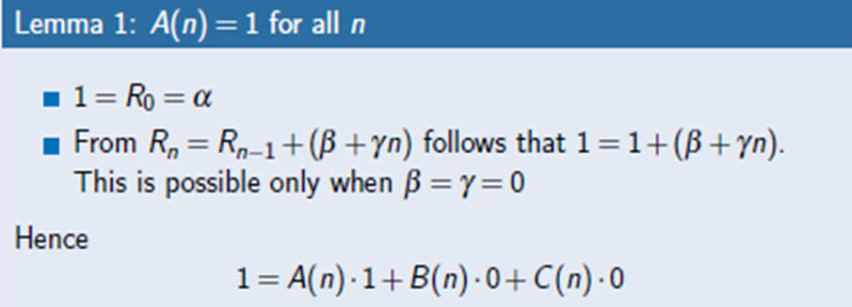
Example-1: Using Repertoire Method

Slide 14
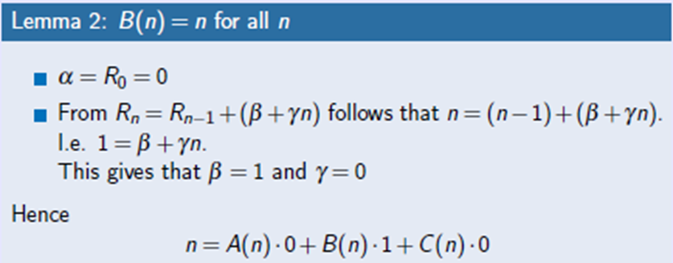
Example-1: Using Repertoire Method

Slide 15
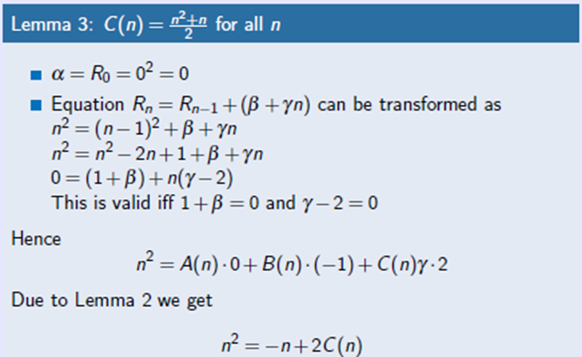
Example-1: Using Repertoire Method

Slide 16
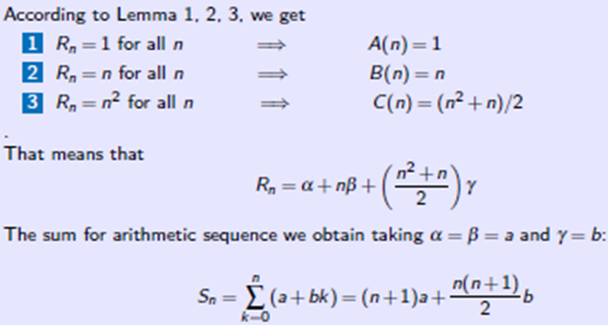
Example-1: Using Repertoire Method

Slide 17
Reduction of Recurrences to Sums
Many recurrences can be reduced to sums: The Tower of Hanoi recurrence is a case in point
T₀ = 0 ;
T_{n} = 2T_{n-1} + 1 ; for n > 0:
if we divide both sides by 2^{n}:
T₀=2⁰ = 0;
T_{n}/2^{n} = T_{n-1}/2^{n-1} + 1/2^{n} ; for n > 0:

Slide 18
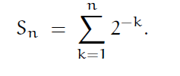
Tower of Hanoi recurrence to Sums
Now we can set S_{n}= T_{n} /2^{n}, and we have
S₀ = 0;
S_{n} = S_{n-1} + 2^{-n} ; for n > 0:
It follows that
S_{n} =

Slide 19
Tower of Hanoi recurrence to Sums
We have converted T_{n} to S_{n} in this derivation by noticing that the recurrence could be divided by 2^{n}. This trick is a special case of a general technique that can reduce virtually any recurrence of the form
a_{n}T_{n} = b_{n}T_{n-1} + c_{n}
to a sum. The idea is to multiply both sides by a summation factor, s_{n}:
s_{n}a_{n}T_{n} = s_{n}b_{n}T_{n-1} + s_{n}c_{n}
This factor s_{n} is cleverly chosen to make
s_{n}b_{n} = s_{n-1}a_{n-1}
Then if we write S_{n} = s_{n}a_{n}T_{n} we have a sum-recurrence,
S_{n} = S_{n-1} + s_{n}c_{n}

Slide 20
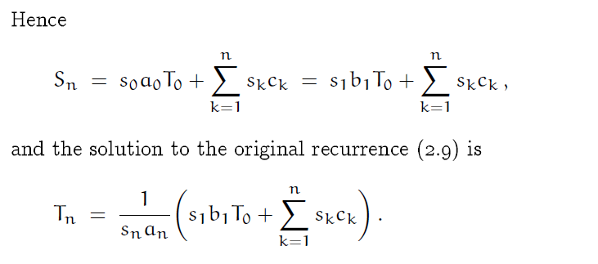
Tower of Hanoi recurrence to Sums
Note: S_{n} = s_{n}a_{n}T_{n}

Slide 21
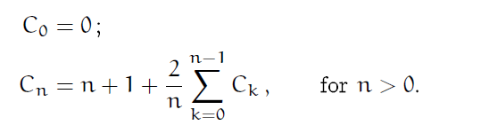
Practice Problem(On Copy-17 OCT)
From this following recurrence solution, reduce it to a sum equation.
Hints:
First get rid of the division from the above equation
Second get rid of the ∑ sign
Then perform subtraction from the generated two equation
Simplify it to a C_{n}
Last compare with the a_{n}T_{n} = b_{n}T_{n-1} + c_{n}

Slide 22
Perturbation Method
A mathematical technique to eliminate linear terms in an equation in order to retain the nonlinear (turbulence) terms. Variables such as potential temperature (θ) or velocity (U) can be partitioned into mean (slowly varying) and perturbation (rapidly varying) components.

Slide 23

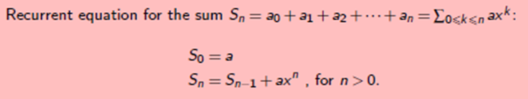
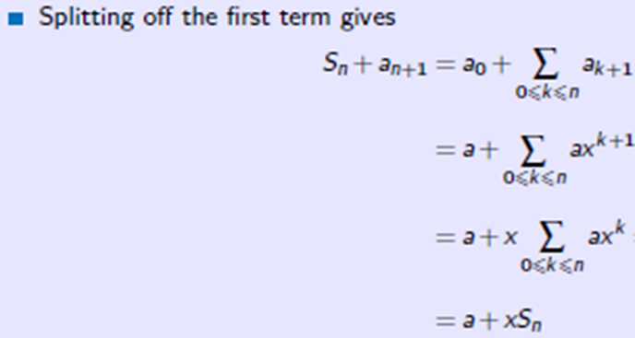
Example-2: Using Perturbation Method

Slide 24
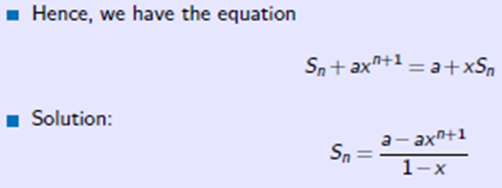
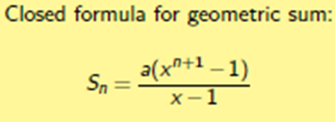
Example-2: Using Perturbation Method

Slide 25

Practice Problem
Using Perturbation technique, find out the closed formula for the following sum.

Slide 26
General Methods
Guessing the answer and prove the guess by induction
Perturbation
Build a repertoire

Slide 27
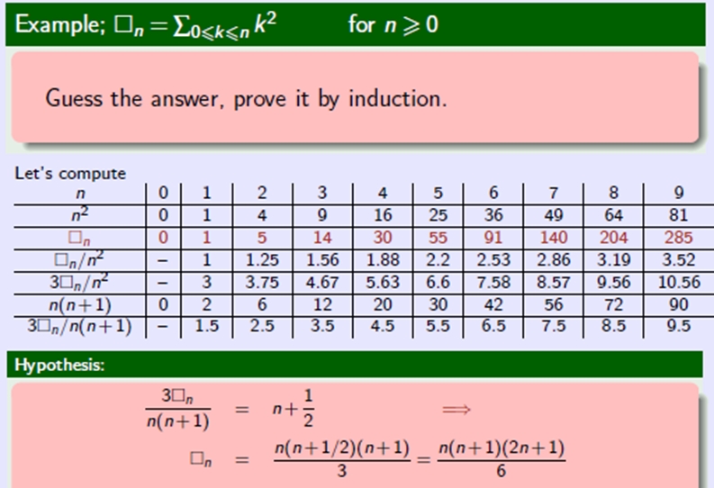
Guess the Answer

Slide 28
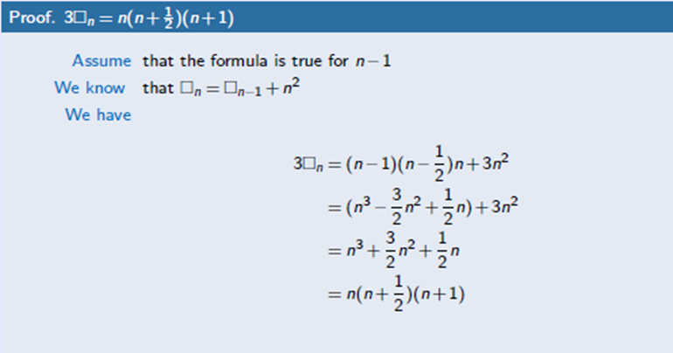
Guess the Answer

Slide 29
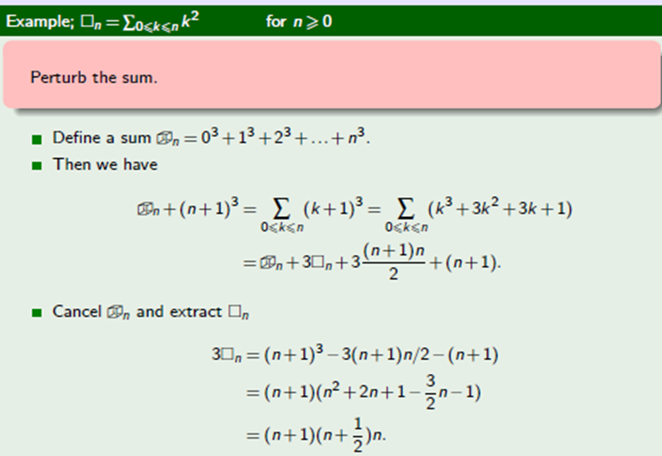
Perturbation

Slide 30
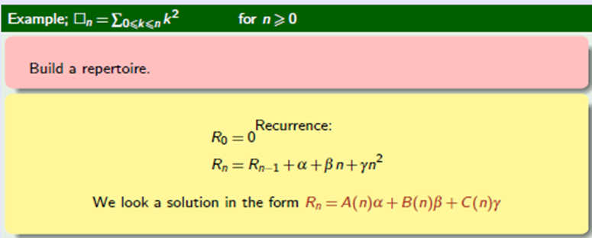
Build a Repertoire

Slide 31
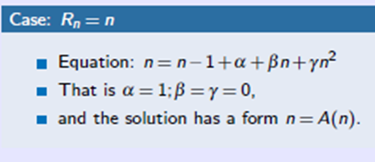
Build a Repertoire

Slide 32
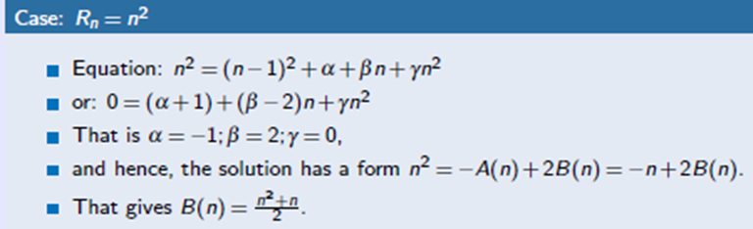
Build a Repertoire

Slide 33
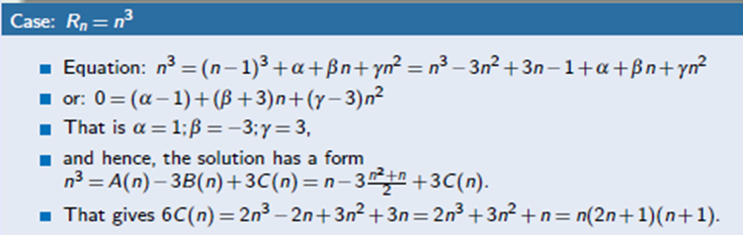
Build a Repertoire

Slide 34
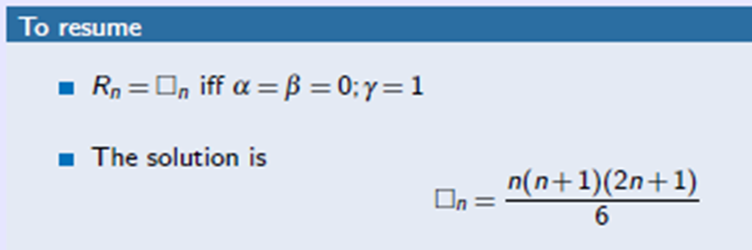
Build a Repertoire

Slide 35
Thank You

